Slide 1

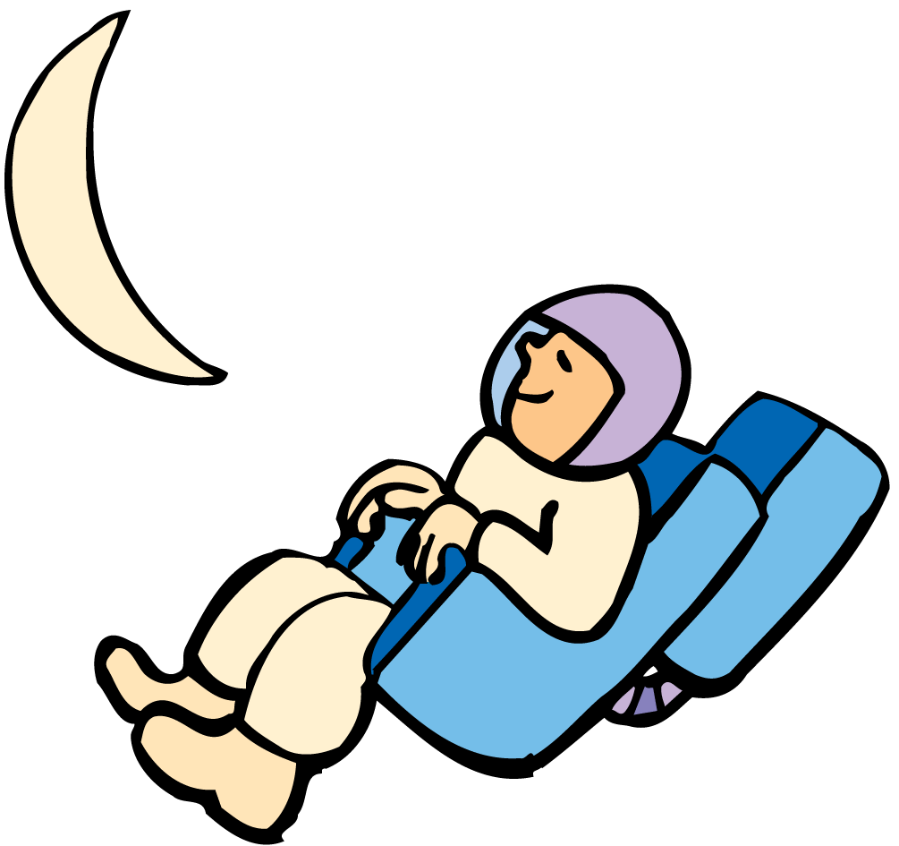

Universal Gravity Notes
Everything pulls on everything else.

Slide 2
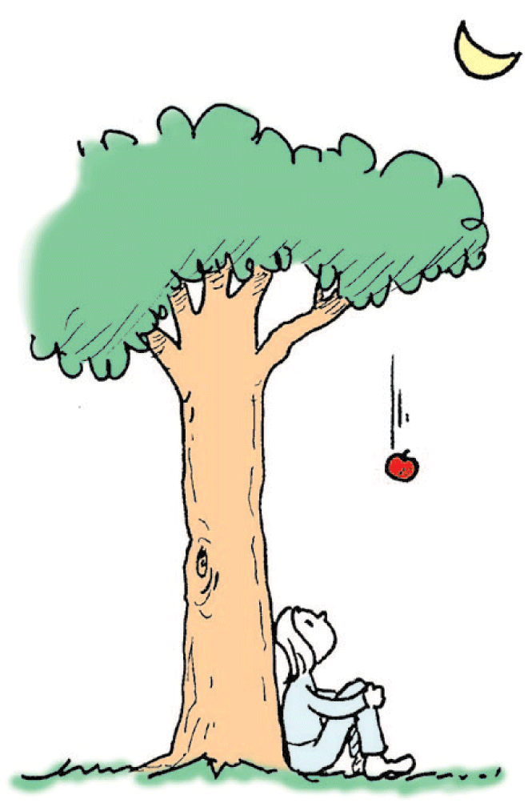
The Falling Apple
Gravity was not discovered by Isaac Newton.
What Newton discovered, prompted by a falling apple, was that gravity is a universal force—that it is not unique to Earth, as others of his time assumed.

Slide 3
The Falling Apple
Newton understood Conservation of Momentum, as only a force (impulse) would cause a change in momentum.
He knew that without an outside force, moving objects continue to move at constant speed in a straight line.
He knew that if an object undergoes a change in speed or direction, then a force is responsible.
He observed that the apple would increase it’s speed as it fell towards the earth.
He also observed that planets did not follow a straight line path, but a circular path, thus constantly changing their direction.

Slide 4

Newton’s Law of Universal Gravitation
Newton discovered that gravity is universal. Everything pulls on everything else in a way that involves only mass and distance.

Slide 5
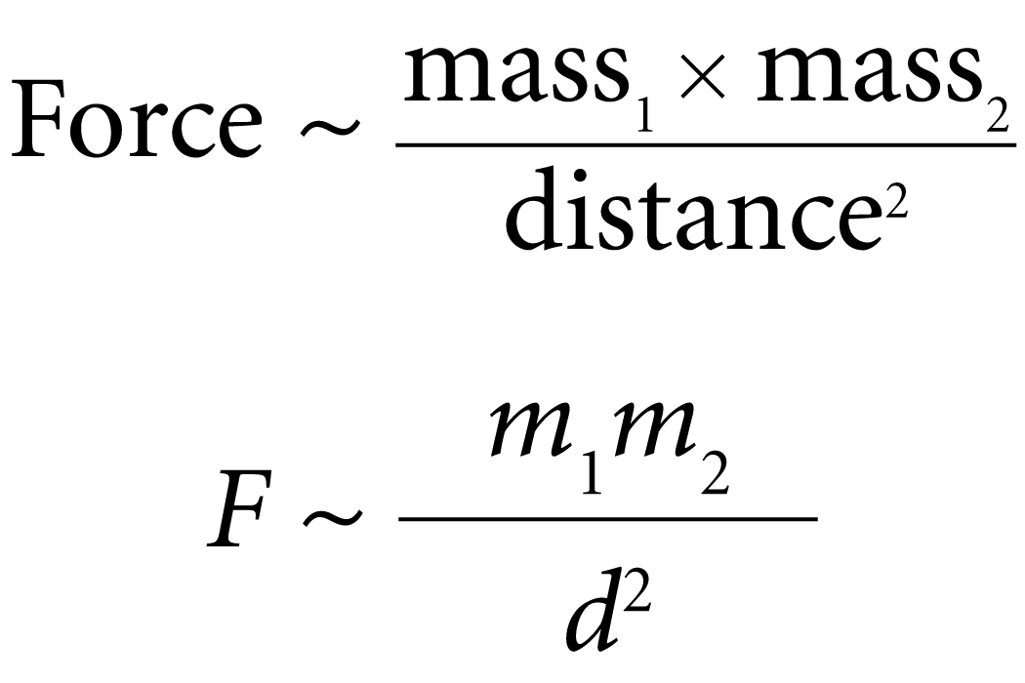
Newton’s Law of Universal Gravitation
Newton’s law of universal gravitation states that every object attracts every other object with a force that for any two objects is directly proportional to the mass of each object.
Newton deduced that the force decreases as the square of the distance between the centers of mass of the objects increases.

Slide 6
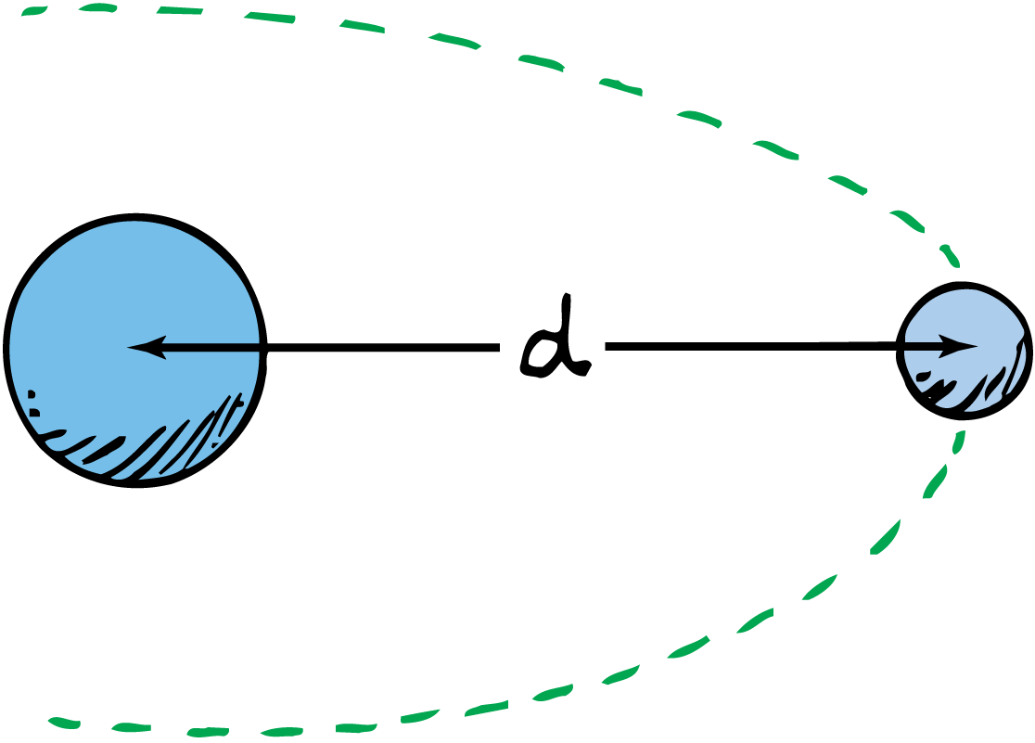
Newton’s Law of Universal Gravitation
The force of gravity between objects depends on the distance between their centers of mass.

Slide 7
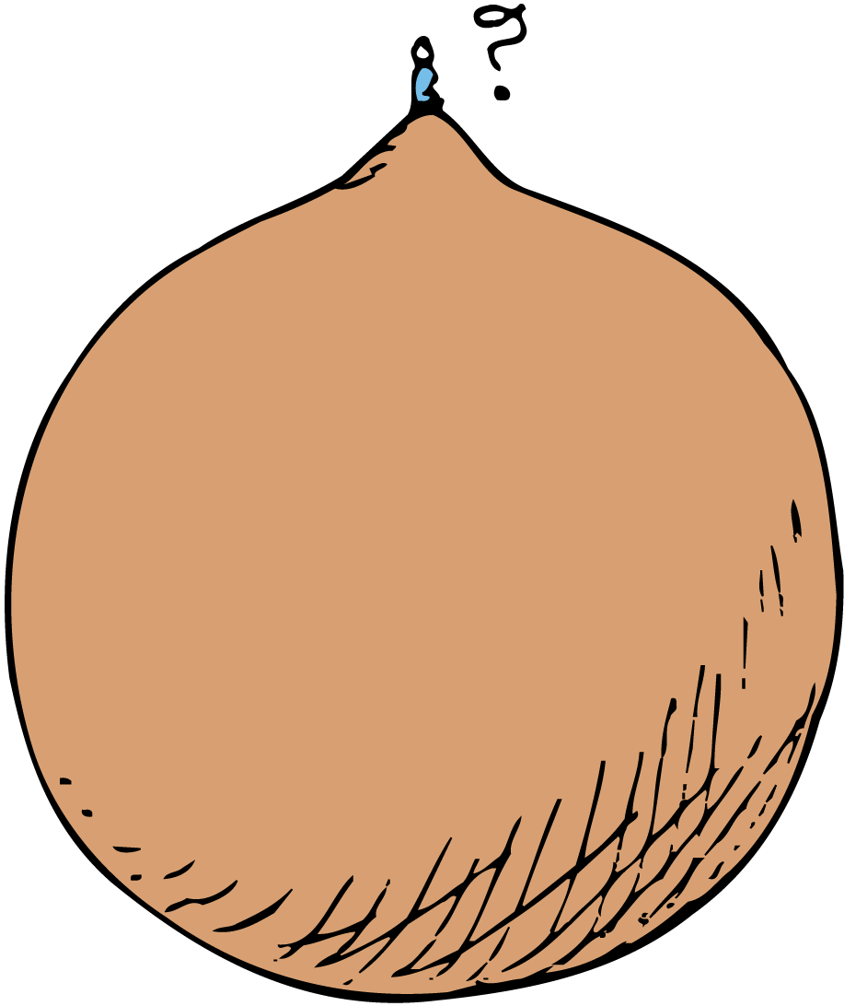
Newton’s Law of Universal Gravitation
Your weight is less at the top of a mountain because you are farther from the center of Earth.

Slide 8
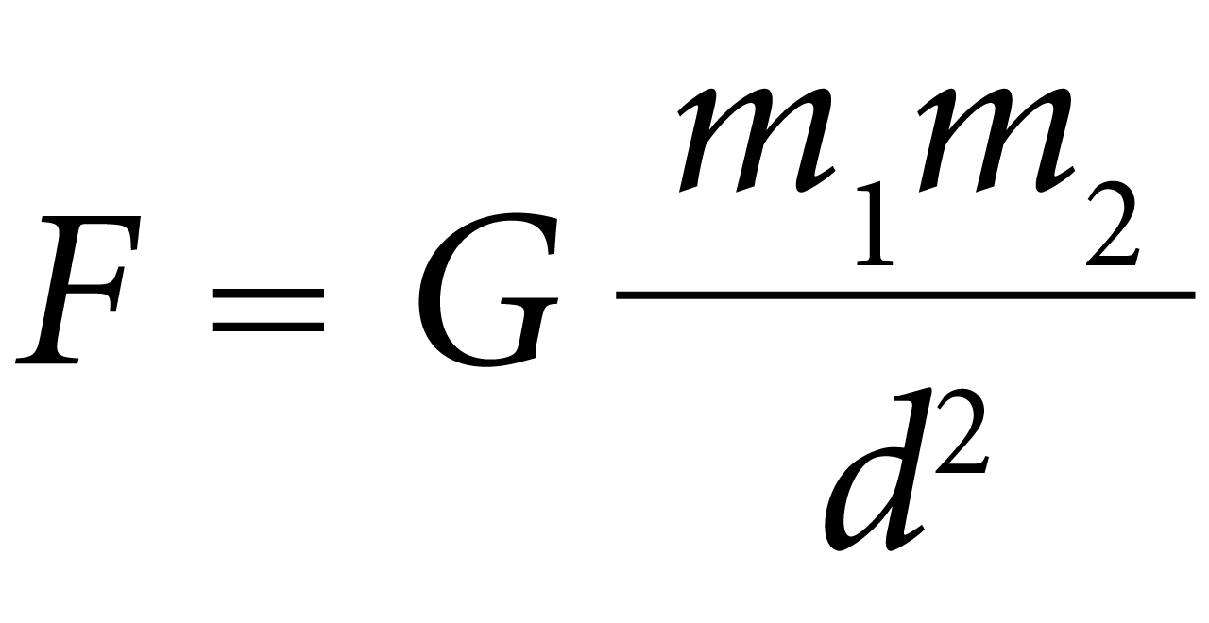
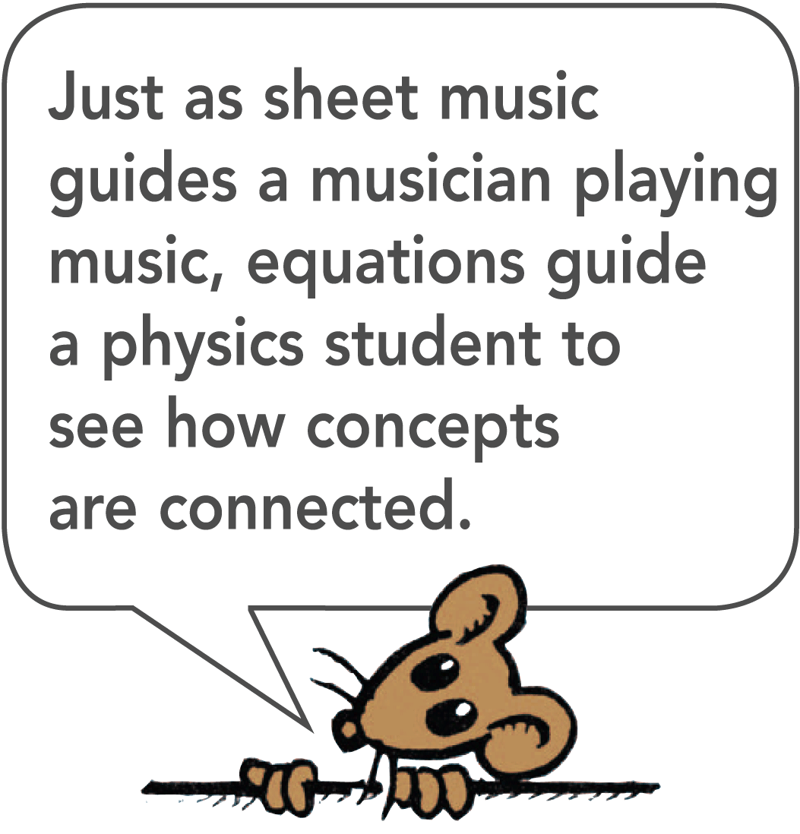
Newton’s Law of Universal Gravitation
The Universal Gravitational Constant, G
The law of universal gravitation can be expressed as an exact equation when a proportionality constant is introduced.
The universal gravitational constant, G, in the equation for universal gravitation describes the strength of gravity.

Slide 9
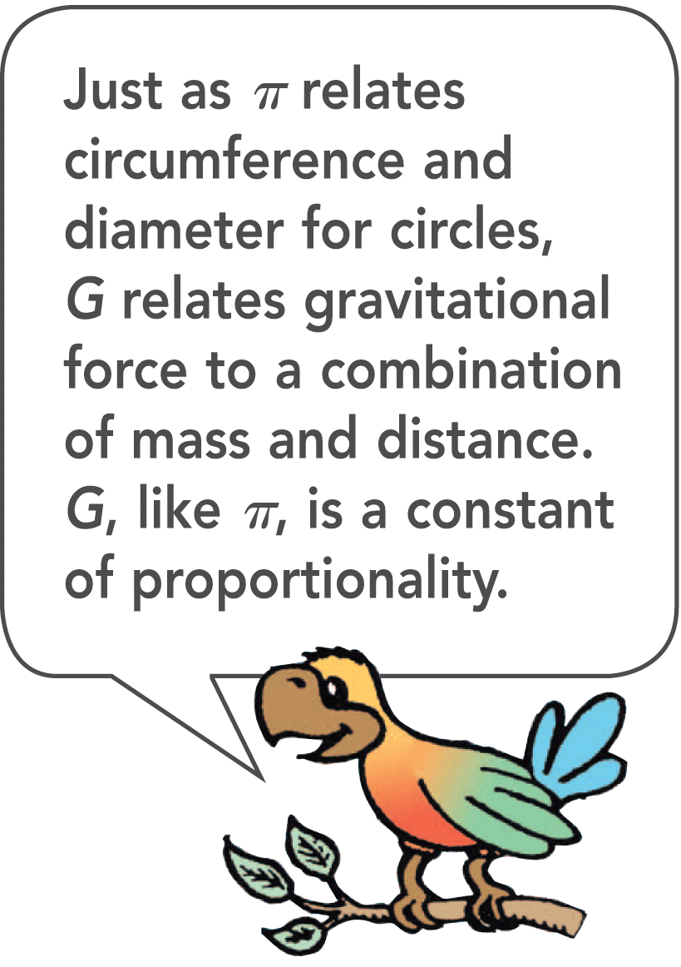
Newton’s Law of Universal Gravitation
The force of gravity between two objects is found by multiplying their masses, dividing by the square of the distance between their centers, and then multiplying this result by G.
The magnitude of G is given by the magnitude of the force between two masses of 1 kilogram each, 1 meter apart: 0.0000000000667 newton. (In scientific notation: G = 6.67 × 10⁻¹¹ N·m²/kg²)
The units of G are such as to make the force of gravity come out in newtons.

Slide 10
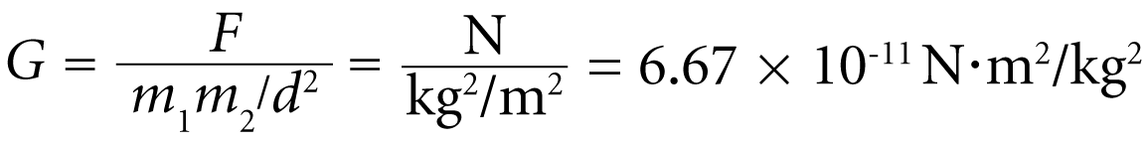
Jolly Method
A simpler method was developed by Philipp von Jolly.
He attached a spherical flask of mercury to one arm of a sensitive balance.
A 6-ton lead sphere was rolled beneath the mercury flask.
The flask was pulled slightly downward.
The gravitational force F, between the lead mass and the mercury, was equal to the weight that had to be placed on the opposite end of the balance to restore equilibrium.
F, m₁, m₂, and d were all known, so the ratio G was calculated:

Slide 11
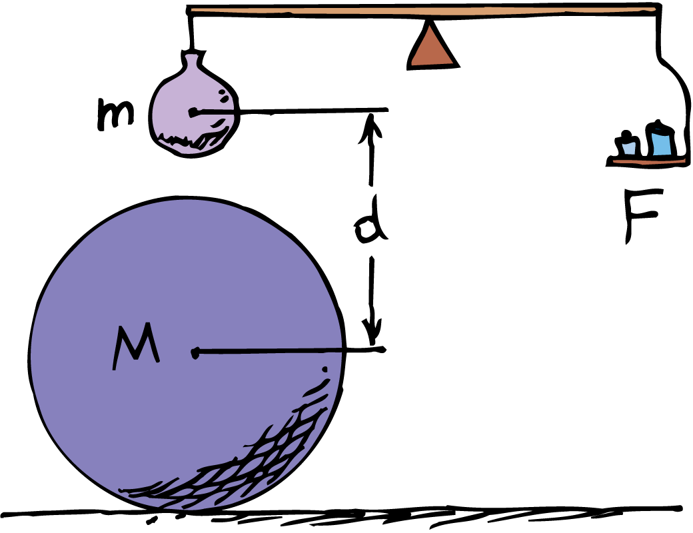
Newton’s Law of Universal Gravitation
Philipp von Jolly developed a method of measuring the attraction between two masses.

Slide 12
Newton’s Law of Universal Gravitation
The value of G tells us that gravity is a very weak force.
It is the weakest of the presently known four fundamental forces.
We sense gravitation only when masses like that of Earth are involved.
The Four Forces;
Gravitational
Electromagnetic
Strong Interaction
Weak Interaction

Slide 13
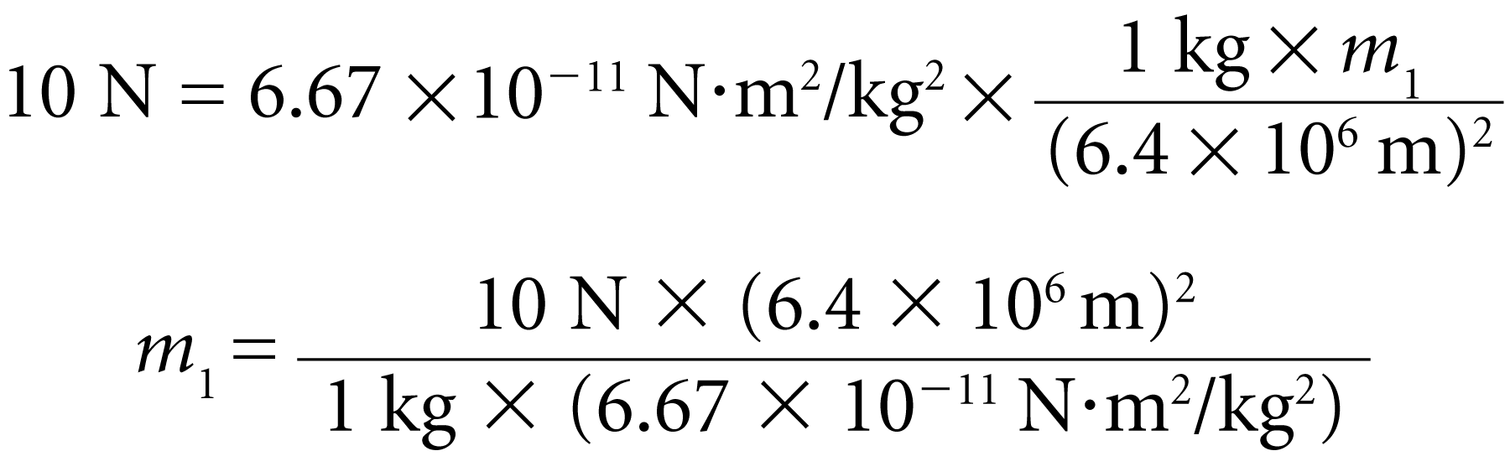
Newton’s Law of Universal Gravitation
“Weighing the Earth” experiment.
Once the value of G was known, the mass of Earth was easily calculated.
The force that Earth exerts on a mass of 1 kilogram at its surface is 10 newtons.
The distance between the 1-kilogram mass and the center of mass of Earth is Earth’s radius, 6.4 × 10⁶ meters.
from which the mass of Earth m₁ = 6 × 10²⁴ kilograms.

Slide 14
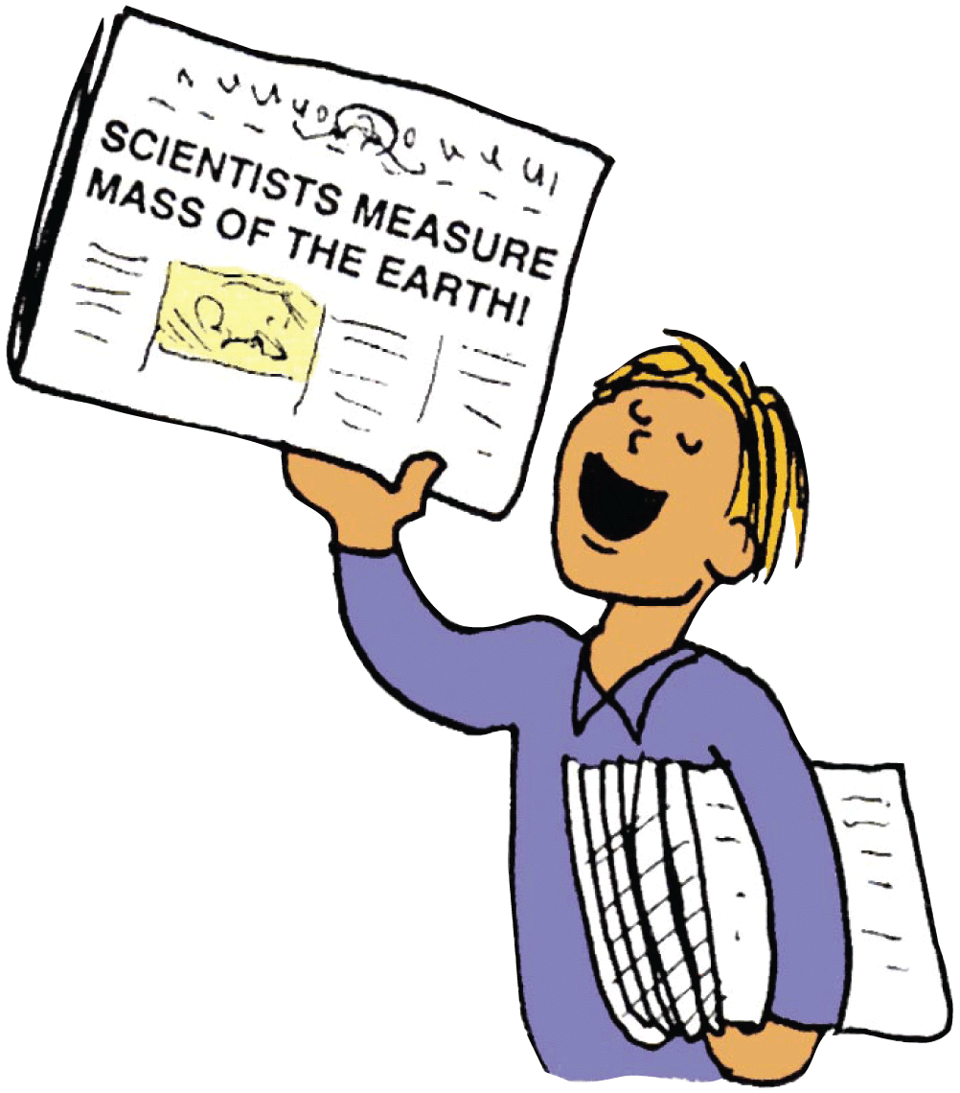
Newton’s Law of Universal Gravitation
When G was first measured in the 1700s, newspapers everywhere announced the discovery as one that measured the mass of Earth.

Slide 15
Gravity and Distance: The Inverse-Square Law
Gravity decreases according to the inverse-square law. The force of gravity weakens as the square of distance.

Slide 16
Gravity and Distance: The Inverse-Square Law
This law applies to the weakening of gravity with distance.
It also applies to all cases where the effect from a localized source spreads evenly throughout the surrounding space.
Examples are light, radiation, and sound.

Slide 17
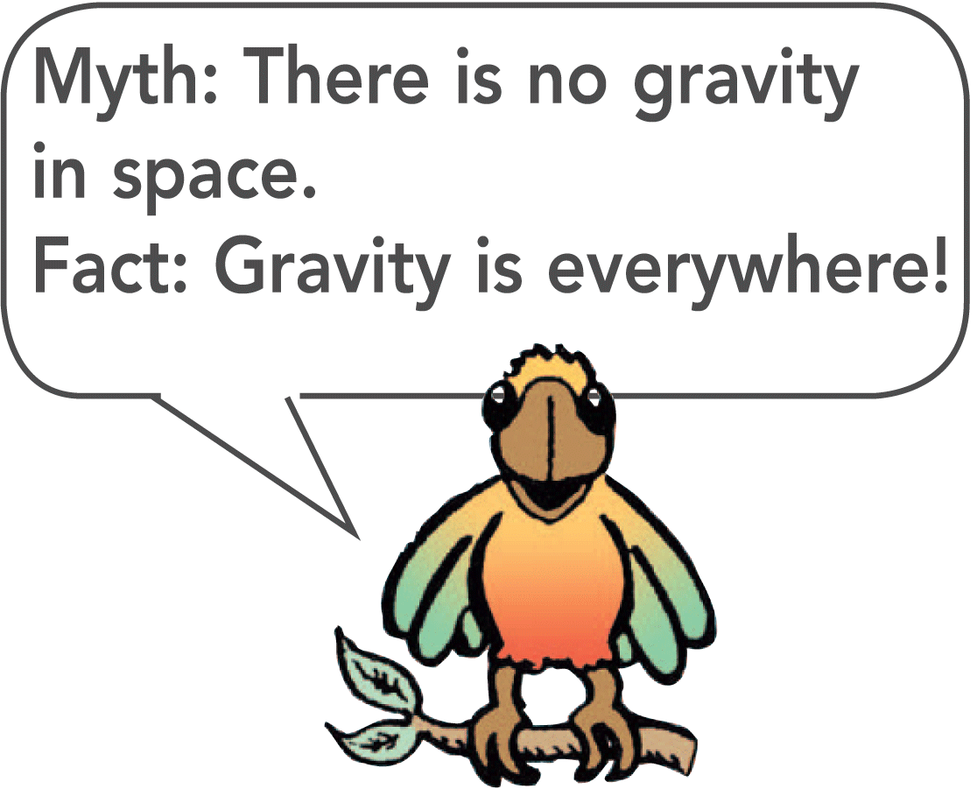
Gravity and Distance: The Inverse-Square Law
The greater the distance from Earth’s center, the less an object will weigh.
An apple that weighs 1 N at Earth’s surface weighs only 0.25 N when located twice as far from Earth’s center.
When it is 3 times as far, it weighs only 1/9 as much.
But no matter how great the distance, Earth’s gravity does not drop to zero.
The gravitational influence of every object, however small or far, is exerted through all space.

Slide 18
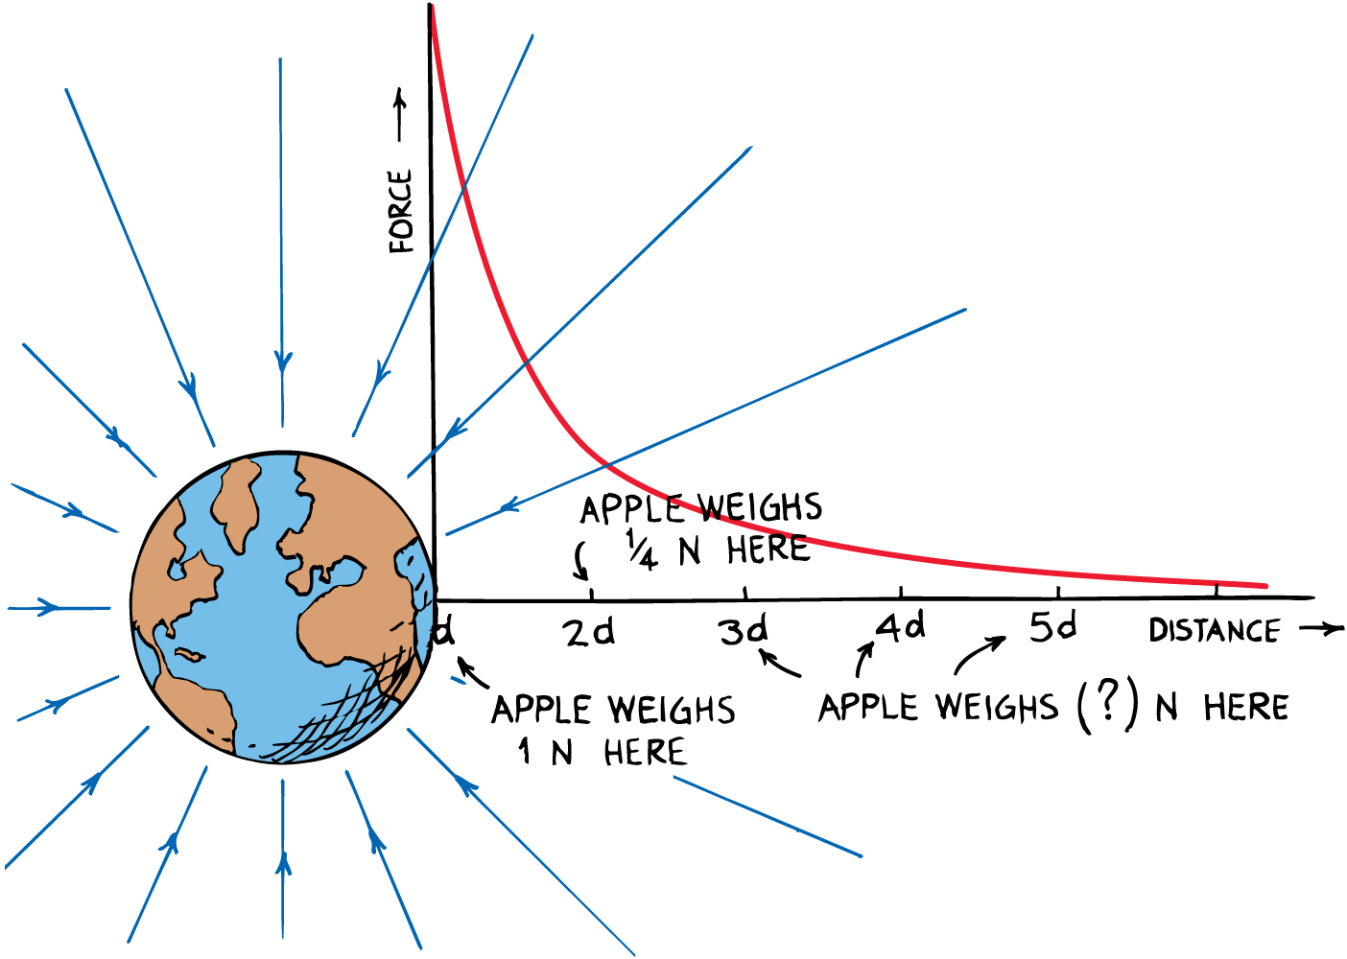
Gravity and Distance: The Inverse-Square Law
Gravitational force is plotted versus distance from Earth’s center.

